Slide 1
Week 10/30

Slide 2
Overview of Work
Created basic flask frontend and connected it with helics

Slide 3
Actual Work

Slide 4
Work - Tyler
Been busy this last week so was not able to do much but I have started setting up lab environments on my localhost VM’s to demonstrate the various attacks Zach and I came up with. Currently working on setting up a SYN flood demonstration.
Talked with the rest of the team about how we should go forward and finish out the rest of this semester, as well as starting to come up with tests to fulfill the testing documentation.

Slide 5
Work - Zach
Described each attack in terms relating to our electric grid
DDOS - directly affects the network by stopping communication between one or more computers
Live Boot - Gaining “physical” access to the computer a bad actor could take down the computer for any period of time, steal data, or scramble the network.
Protocol - By over consuming resources on a specific section of the network other sections of the network will have to pick up the slack causing slowdowns or service blackouts.
Spyware - steal credentials of certain machines and send fake commands to the grid.
Wireshark - Steals packets that are being transmitted unencrypted across the network, man in the middle attack by modifying the messages being sent
Keystroke Injection Attack - execute malicious code in the same style
SolarWinds - upload malware into the network and let a multitude of hacks propagate disabling the grid.

Slide 6
Work - Zach
Setup local hosts for attack demonstrations
Configure Kali VM within our network diagram
Question:
How hands off do you want the attacks to be?
I.e. do you want them all to be executed from the simulator front end or if someone has to go into the kali box to execute them
Should we create a separate front end application to launch attacks from or keep it within the main application dashboard kaya is creating?

Slide 7
Kaya’s Work
Tried using dss_python, but still encountered errors
Need Tommy and Matt’s help for the pandapower/dss/helics connection
Created barebones flask frontend, and connected it to receive the output of the helics graphs.
Used static file to prevent against directory traversal attacks.

Slide 8
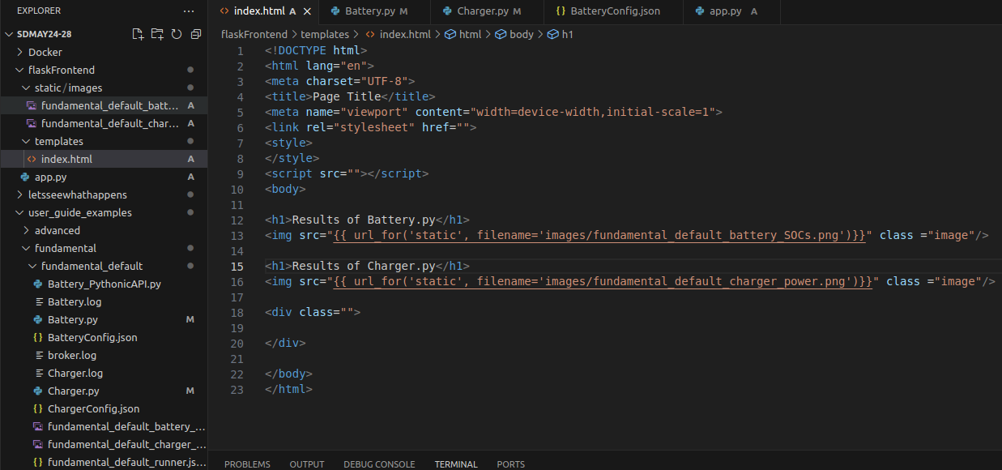
Kaya’s Work

Slide 9
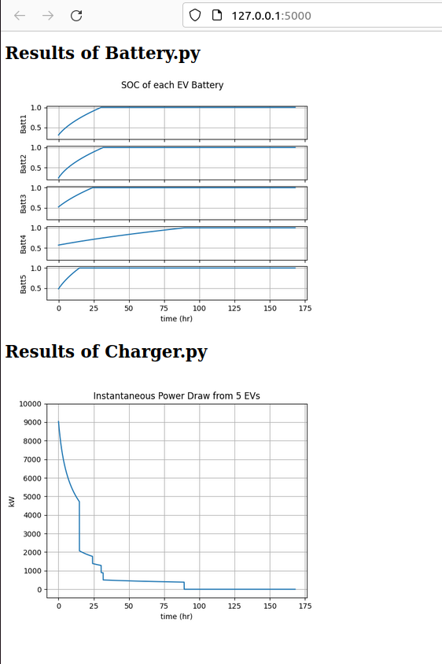
Kaya’s Work
Flask app

Slide 10
Justin’s Work
Experimented more with Docker
Got the Dockerfile for helics updated to Ubuntu 22.04
Smaller Linux images (Alpine) did not work with Helics
Helics is pretty heavy for Docker
VMs are ready to be pushed to individuals

Slide 11
Justin’s Work

Slide 12
Work - Matt/Tommy
Need copies of VMs so that we can run more simulations, hard to use master VM as we are all trying to do different things on it
Trying to look into how to cosimulate PandaPower and OpenDSS_python
Not sure how this will work, cant find much information online
Will need to try through trial and error
I think we will want to send our output from PandaPower to a PQ bus in OpenDSS
Different voltage files in OpenDSS
Line-Neutral and Line-Line voltages by bus and node (most useful file)
Provided in phasors and different elements
Power delivery elements
Power conversion elements

Slide 13
Work - Matt/Tommy
How to export voltage files
CSV files
Right click main window and click “Change to this directory”
Can be export to excel
Sequence voltage file is very similar to Line-Neutral voltage file
Voltage elements, shows N terminals, N conductors, and voltage phasors
PandaPower
Found a new series of youtube tutorials to start watching
Need to explore how data can be transferred to OpenDSS
Think we will need voltage bases and values to match
Current shouldnt be relevant

Slide 14
Work - Matt/Tommy
OpenDER
Tried looking for more information and was following examples from update slides on EPRI Website
Is there a tutorial/manual that you know of that could help find a starting point

Slide 15
Next Week's Plan
https://www.epri.com/OpenDER
https://github.com/epri-dev/OpenDER
https://www.epri.com/research/products/000000003002025583
PUT OPENDER in DSS_PYTHON

